Slide 1

Module 3: Installing Siebel Relationship Management Warehouse Components
0/5
Analytics: Data Warehouse Developer (Siebel 7.7)
Notes:
Time: Lecture: 55 minutes; labs: 90 – 120 minutes
Intent: This module presents the installation process, broken down by machine.
Flow: Verify prerequisites, installation and configuration per machine; ETL Clients machine; Informatica client and ODBC; DAC Client; ETL Servers machine; creating ODBC connections; Informatica Server; DAC Server; Registering PMCMD path; PMCMD command; create databases on the database server machines; set up the data warehouse; set up DAC repository; set up data warehouse; using Data Warehouse Configuration wizard; registering the Informatica repository; configure connection between DAC Server and DAC repository; register Informatica Server in DAC; apply SIF file; evaluate ETL performance; granting access; creating users; installation process overview
Key Terms:
DAC Server
DAC client
Informatica Server
Informatica Client utilities
DAC repository
Informatica repository
Data Warehouse Configuration wizard
ETL Servers machine
SRMW Database machine
ETL Repositories machine
ETL Clients machine
ODBC
3

Slide 2
Module Objectives
After completing this module you will be able to:
  Install the components on each machine in a Siebel Relationship Management Warehouse (SRMW) implementation
  Detail the required steps for each installation
  Explain the use of components on each machine
  Identify steps to grant access to SRMW from Siebel Analytics application
Why you need to know:
  To achieve optimal performance for the Siebel Relationship Management Warehouse system, it is necessary that all components be correctly installed
Notes:
Each objective and “why you need to know” should be stated aloud.

Slide 3
Verify Prerequisites
Verify hardware configuration for server and client components
  Refer to Informatica documentation
Verify server-specific settings for the SRMW Database
Verify locale, codepage, and Unicode settings for Informatica and database software
  For deployment environments where the Siebel transaction database and SRMW are on different codepages or Unicode, the following are the supported environments
Source | Target
Codepage | Unicode
Codepage | Codepage (if both codepages are the same)
Unicode | Unicode (both UTF8 and UC2 are supported)
Notes:
Another useful reference for hardware requirements and installation is the System Requirements and Supported Platforms Guide, available on SupportWeb.
3

Slide 4
Installation and Configuration per Machine
Install software on the ETL Clients machine
Install software on the ETL Servers machine
Create databases on the SRMW Database and ETL Repositories machines
Transactional Database
ETL Servers
SRMW Database
ETL Clients
ETL Repositories
Notes:
This is the order in which the software should be installed. The following slides are structured in this order.

Slide 5
Install Software on ETL Clients Machine
Install software on the ETL Clients machine
  Install Informatica client software
  Create database connections
  Install DAC client
ETL Clients
Notes:
These are the components installed on the ETL Clients machine. Note that all Informatica clients access and manipulate the Informatica repository. The DAC client accesses and manipulates the DAC repository.
The main point of this machine is to put all the tools needed to manage the repository, users, ETL, and so forth in one place for all administration. Depending on their model, for instance, this machine might also include any other client utilities (SQL Enterprise Manager and SQL Query Analyzer, to manage the database(s) from the machine).
Remind students that in the labs they will be installing everything on one machine.
3

Slide 6
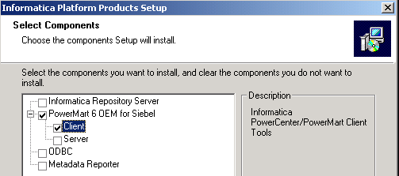
Install Informatica Client Software
Install the Informatica client utilities
  Informatica Workflow Manager—customizes mappings, workflows, and other objects in the Informatica repository
  Informatica Repository Manager—restores and manages the Informatica repository
  Informatica Designer—configures and updates the SRMW mappings, transformations, and metadata
Install Informatica PowerMart Client per instructions in the Informatica documentation
Notes:
This slide highlights necessary steps to install the Informatica client. The same wizard that installs the Informatica client software can also install the Informatica server software. Students run this install twice in the lab choosing each individually.

Slide 7
Create Database Connections
For the transactional and analytical systems:
  Create an ODBC connection and a native connection to the SRMW
    Used when creating and loading the data warehouse and Informatica repository
  Create a native connection to the Siebel transactional database
Notes:
This slide explains the need to create ODBC connections. Note that students create the necessary ODBC connections in the labs.
3

Slide 8
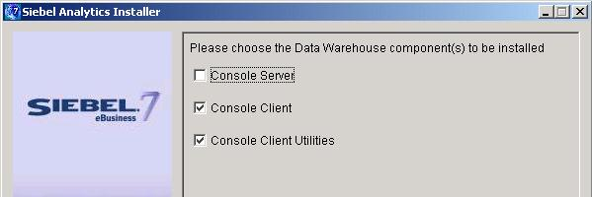
Install DAC Client
Creates and configures:
  SRMW tables
  Informatica repository
Launches and manages ETL process
Installs from the Siebel Analytics installer
DAC Client
Notes:
This slide details how to install the DAC client. Students do this in the labs.

Slide 9
Install Software on ETL Servers Machine
Install software on the ETL Servers machine
  Informatica Server
  Informatica Repository Server
  DAC Server
  ODBC drivers
ETL Servers
Notes:
These are the components installed on the ETL Servers machine. The Informatica Server processes ETL requests issued from the DAC Server. The Informatica Repository Server manages access to the Informatica repository.
3

Slide 10
Informatica Server
Informatica Server performs the following:
  Extracts data from the transactional database
  Transforms data to fit the needs of the analytical schema
  Loads data into the Siebel Relationship Management Warehouse
To install:
  Log in as administrator
  Install PowerMart Server
  Configure Platform key and RDBMS key
  Configure hostname and domain
  Configure connection to repository and Siebel database:
    Repository name
    Database type
    Username/Password
  Set up Informatica service:
    Uses System Account
Notes:
This slide expands on the role of the Informatica server and lists the key steps in its installation. Students perform this installation in the labs. In the student note, it is pointed out that the default names of the ODBC connections are OLTP and OLAP. Because of this, the ODBC connections from the Data Warehouse Server machine need to use this naming convention.

Slide 11
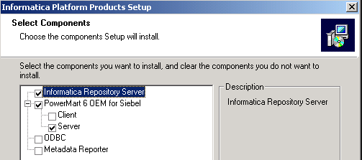
Informatica Repository Server
Informatica Repository Server manages the Informatica repository
Manages repository connection requests, including locking during repository metadata update
Notes:
This slide expands on the role of the Informatica Repository Server. Students perform this installation in the labs. The screenshot shows the selection of the Repository Server.
3

Slide 12
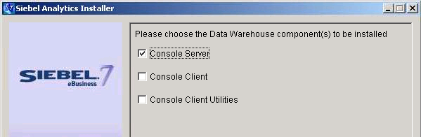
DAC Server
Accesses DAC repository to schedule and manage ETL
Installs from the Siebel Analytics installer
DAC Server
Notes:
The DAC Server is installed from the Siebel Analytics installer. Students install the server in the labs.

Slide 13
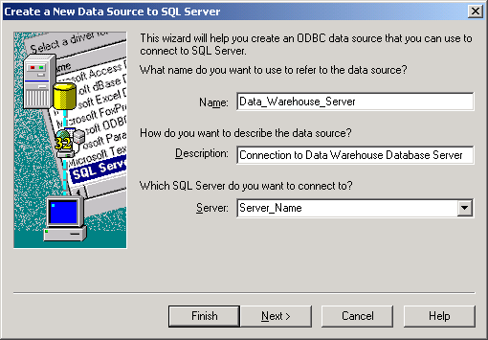
ODBC Drivers
Register database connections used to connect to the SRMW and repositories
  Create and check the ODBC connections
  Required for Informatica repository, DAC repository, and SRMW
Notes:
This slide highlights the need for ODBC connections to the Siebel Relationship Management Warehouse database.
3

Slide 14
Register the PMCMD Path
PMCMD is used by the DAC Server to issue commands to the Informatica Server to run ETL workflows
  Command line interface to the Informatica Server
Select Start > Settings > Control Panel > System
In the Advanced tab of the System Properties dialog box, edit the PATH system variable to include the path to the PMCMD command
  PMCMD is located in the bin directory of the Informatica Server
  Example: C:\Program Files\Informatica\Informatica PowerMart 6.2.1 OEM for Siebel – Server\bin
Notes:
This slide highlights the steps to register the PMCMD path. The PMCMD command is described on the next slide. It is used by the DAC Server to issue commands to the Informatica Server, so the path needs to be registered in the PATH system variable of the ETL Servers machine.

Slide 15
PMCMD Command
Informatica PMCMD command is used by DAC Server to initiate workflows in the Informatica repository
Syntax:
    “[PATH variable]\PMCMD" start %INFA_USER %INFA_PASSWORD 4001 Siebel_DW_Rep:SDE_AssetFact 0 0
Calls PMCMD
User name variable
Password variable
Port number
Repository folder
Workflow name
Indicates workflow
Nowait option
Notes:
This slide details the use and syntax of the PMCMD command line utility, which is used by the DAC Server to submit ETL workflows on the Informatica Server for execution.
Walk students through the components of the PMCMD utility’s syntax.
3

Slide 16
Create Databases on Database Server Machines
Create databases on the SRMW Database and ETL Repositories machines
Set up the DAC repository
Set up the SRMW database
  Set up data warehouse
  Run the Data Warehouse Configuration Wizard
Set up the Repository Database
  Register and edit the Informatica repository
SRMW Database
ETL Repositories
Notes:
This slide describes what to set up on each of the Database Server machines. Again, the SRMW Database and the Repository Databases can exist on one physical machine, but are recommended to be separate for performance reasons.

Slide 17
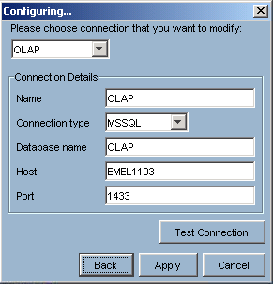
Set Up DAC Repository
Launch the DAC client (Start > Programs > Siebel Analytics > Siebel DAC > DAC Client)
Click Configure to specify the database connection parameters
  Modify or create a new connection to the DAC repository’s database
  Specify connection information
Notes:
Upon initial launch of the DAC Client, the connection to the ETL Repositories component is configured. Once this is configured, you can log into the DAC Client.
3

Slide 18

Set Up DAC Repository Continued
Log into DAC client
Click Yes to create the DAC repository tables
Select Tools > DAC Repository Management > Import
  Imports DAC repository seed data
Notes:
Upon initial login to the DAC Client, you are prompted to create the DAC repository tables. When you click Yes, the DDL to create the DAC repository tables is run by the DAC Server. Finally, to import seed data into the tables, you select Tools > DAC Repository Management > Import. Students set up the DAC repository in the labs.

Slide 19
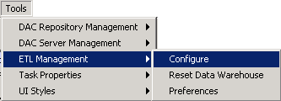
Set Up Data Warehouse
Verify that a role named SSE_ROLE is created for both SRMW and Siebel transaction database
Launch Data Warehouse Configuration Wizard in the DAC client
Notes:
The Data Warehouse Configuration wizard is used to install and configure the Siebel Data Warehouse and Informatica repository tables. Essentially, it is a wizard in the DAC for manipulating and running DDL scripts to install and configure the tables. Students use the wizard in the labs.
3

Slide 20
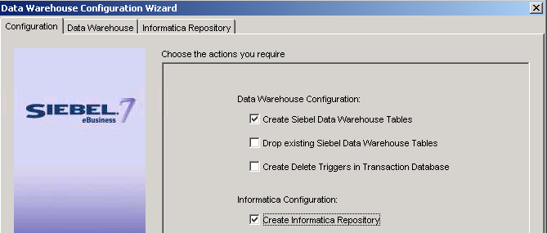
Run Data Warehouse Configuration Wizard
Installs data warehouse tables and builds and configures the Informatica repository
To install the data warehouse tables and Informatica repository:
  Identify connect string, Table Owner, and Platform for existing transactional and data warehouse databases
    Stored in Informatica repository for access during data warehouse population
Notes:
This slide highlights some of the information needed to successfully use the configuration utility. Students input these parameters in the labs.

Slide 21
Register and Edit Informatica Repository
To function, the Informatica repository must be registered with the Informatica Server and the Administrator Workstation
In Informatica Workflow Manager:
  Add the Informatica repository; name = SIEBEL_DW_REP
  Set username to Administrator
  Set up the ODBC Data Source for the Siebel RMW
  Edit the SRMW Server with respect to the machine you are configuring
    Set the Host Name to:
      SRMW Server machine name
    Set $PMRoot to the directory on the Siebel RMW Server machine where the Informatica Server is installed
Notes:
Once the Informatica repository is installed, it must be registered with the Informatica Server. This slide details the steps required and important parameters.
3

Slide 22
Configure Connection Between DAC Server and Repository
The DAC Server must have connection information for the DAC repository
In the DAC client:
  Select Tools > DAC Server Setup
  For the DAC repository database, enter:
    Connection type
    Database name
    Host
    Port
    Table owner name and password
Notes:
Once the DAC repository is installed and seeded, it must be registered with the DAC Server. This slide details the steps required and important parameters.

Slide 23
Register Informatica Server in DAC
The DAC Server must have connection information for the Informatica Server so that it can issue commands
  In the Setup view of the DAC client, select the Informatica Servers tab
  For the Informatica Server:
    Set server name to SIEBEL_DW_SERVER
    Enter hostname of the machine the server is on
    Enter the port it is listening on
    Set login and password both to Administrator
Notes:
The Informatica Server must be registered with the DAC Server so that it can issue Informatica tasks against the Informatica Server. This slide details the steps required and important parameters.
3

Slide 24
Apply the SIF File
Apply the Siebel Information File (.sif file) to create the S_ETL_REF_PARAM and Change Capture (S_ETL_R_IMG_*, S_ETL_I_IMG_*, and S_ETL_D_IMG_*) tables in the Siebel transactional database
  S_ETL_REF_PARAM is required to execute the ETL routines
  Change Capture tables are used in change capture during incremental updates of the SRMW
Notes:
Siebel Tools is used to apply the SIF files to the Siebel transactional database. Applying SIF files to the Siebel transactional database process consists of:
Backing up the repository
Importing the .sif using Siebel Tools
Verifying the application of the .sif
Applying the .sif file contents to the Siebel transactional database schema
Verifying the schema modification

Slide 25
Evaluate ETL Performance
To maximize performance, load data pertinent to your business requirements
  Instead of performing a complete ETL of the data in the Siebel database, configure the ETL process to populate a predefined subset of the star schemas in the SRMW
    Configured ETL process is covered later in the course
Notes:
ETL performance can be improved by pruning, or configuring, the ETL execution plans and other DAC entities to eliminate unnecessary processing. This process is described later in the course and students will perform a lab in which they configure ETL.
3

Slide 26
Grant Access to Siebel Analytics
Siebel Analytics users need to access:
  Siebel Relationship Management Warehouse
  Siebel transactional database
  Analytics client (if necessary)
Analytics Client
Siebel DB
SRMW
Notes:
This is a high-level picture of the security requirements for the Siebel Analytics user. Remember that we are not focusing on the Analytics client or server in this course.

Slide 27
Create Users for Siebel Analytics
Create Siebel users in the standard way, with positions and responsibilities
Grant access to the transactional database and the SRMW database using RDBMS tools
Notes:
Explain how users are created in Analytics. The Siebel Analytics users are created in the Analytics repository in standalone mode or in Siebel CRM application in the case of integrated mode.
3

Slide 28
Installation Process Summary
Analyze prerequisites and recommendations
  Reference: Siebel Data Warehouse Installation and Administration Guide
Perform installation
  Informatica software
  Siebel Analytics software – DW option
  Reference: Siebel Data Warehouse Installation and Administration Guide
Perform configuration
  Informatica software
  Siebel Analytics software – DAC client
  Reference: Siebel Data Warehouse Installation and Administration Guide
Notes:
Where the beginning portion of this module broke the installation out per machine, this slide and the next summarizes the whole installation process at a high-level.

Slide 29
Installation Process Summary Continued
Apply SIF file
Evaluate ETL performance
Notes:
Reference materials are also included.
3

Slide 30
Summary
This module showed you how to:
  Install the components on each machine in a Siebel Relationship Management Warehouse (SRMW) implementation
  Detail the required steps for each installation
  Explain the use of components on each machine
  Identify steps to grant access to SRMW from Siebel Analytics application
Notes:
This slide presents a summary of the topics covered in the module.
Review Questions:
Question: Why do you apply SIF files in the Siebel transactional database?
Answer: These files contain schema definitions for tables used in ETL processing.
Question: What is the purpose of the PMCMD command?
Answer: PMCMD command is used by the DAC Server to issue commands to the Informatica Server.

Slide 31
Lab
In the lab you will:
  Install components on the Administrator Workstation
  Install SRMW tables on the SRMW Database Server
  Install the DAC and Informatica repositories on the Repository Database
  Update the transactional database
Notes:
Labs and Troubleshooting:
See lab instructions for details. Although all components are installed on the student’s machine, the labs are structured per the physical machine context. The database tables and repositories have been consolidated to one machine for purposes of the lab.
3

